Slide 1
Stress and Load Analysis of Folded Spring Systems on MEMS Gyroscope
Andy Xiao, Vicky Chen, Vaibhav Wanere

Slide 2
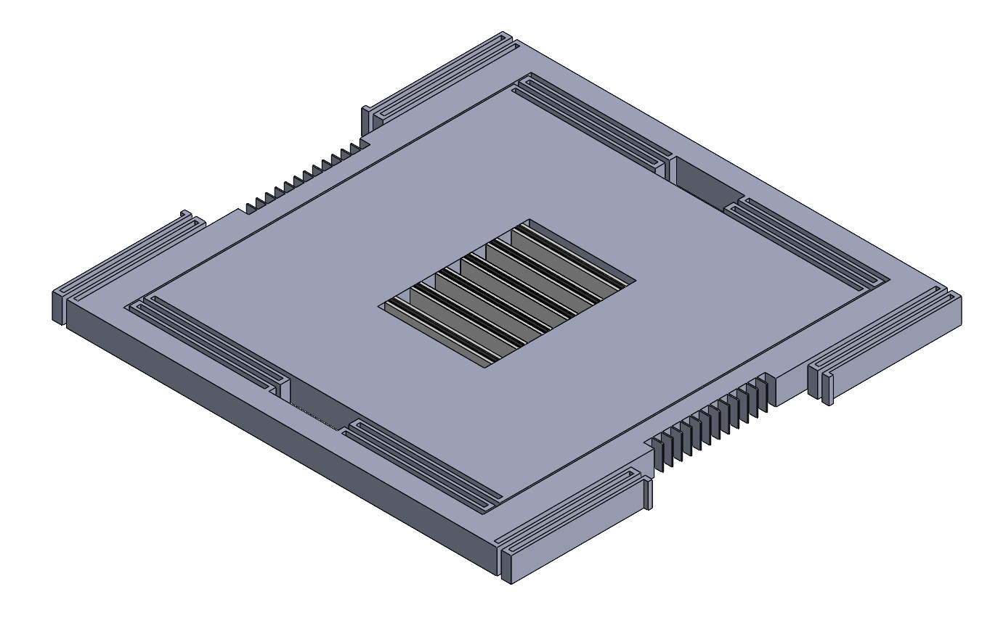
Micro-Electronics Mechanical Gyroscope

